Slide 1
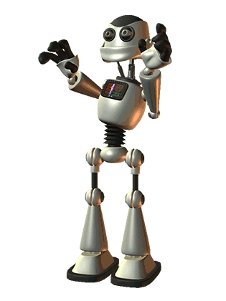
AI Jukebox
An Exploration in Generative Models
Brian McMahon
5 April 2018
Notes:
Don’t say “utilize!”

Slide 2
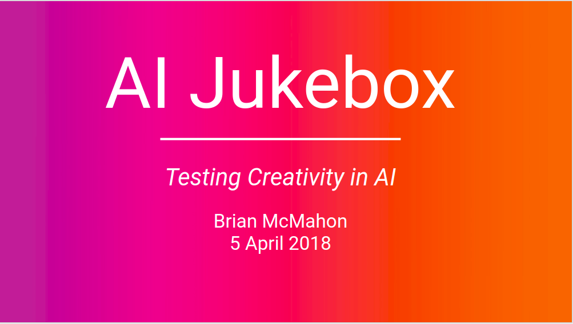

“What I cannot create, I do not understand.”
-Richard Feynman
Creation
^
Understanding
^
Notes:
I’d like to start with a quote by the legendary theoretical physicist, Richard Feynman:
“What I cannot create, I do not understand”
Taking a bit of liberty in interpreting this quote, I would draw out an implied symbiotic relationship between creation and understanding.
This model will gain “machine understanding” by mapping the underlying relationships within a dataset.
From this understanding it is then able to create new and unique content
Richard Feynman, Theoretical Physicist and winner of Nobel Prize
https://en.wikipedia.org/wiki/Richard_Feynman

Slide 3
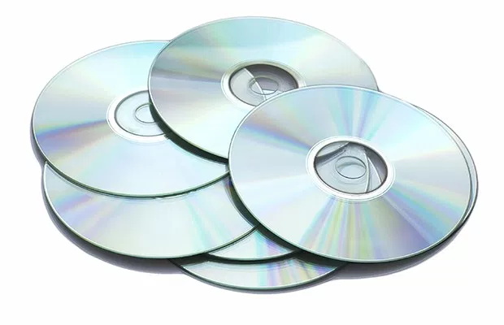
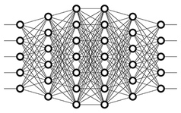
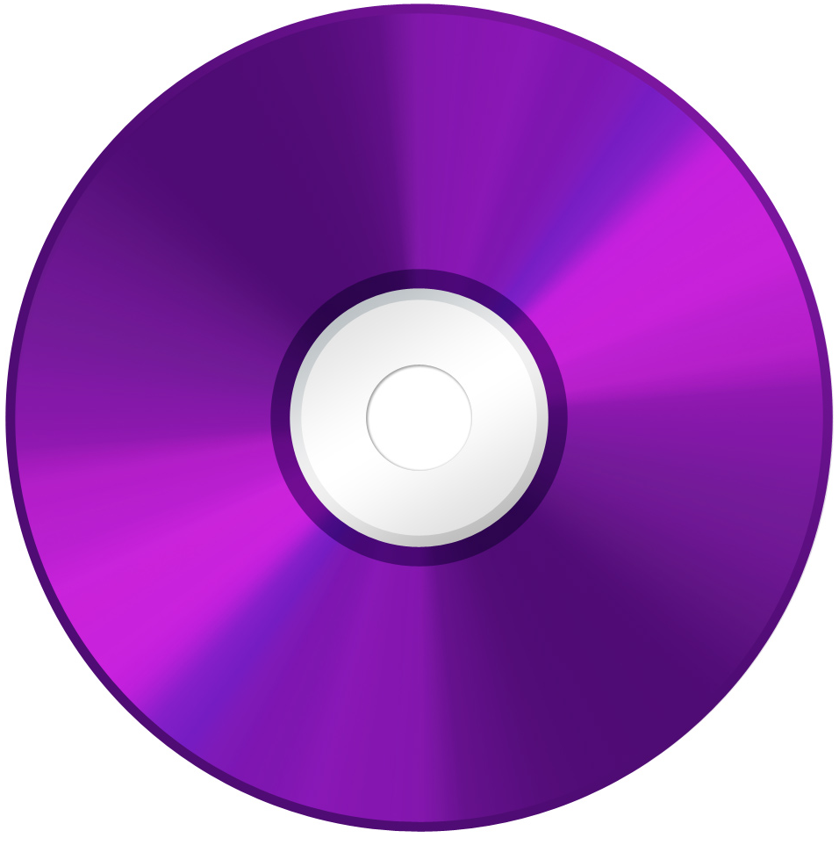
Generative Model
Machine “understanding”
Creation
Potential applications of generative models:
Images
Audio
Text
Code
Design
Blueprints
Physical Structures
Input Dataset
Map Latent Structure
Output Unique Samples
Notes:
Discover hidden structure within data
Generate
Generative models: learn a joint probability distribution
Discriminative models: learn the conditional probability distribution
Speech recognition
Exploring creativity in AI
Investigate generative (as opposed to discriminative) neural networks
Exploring the question: can AI be creative?
Expands scope of artistic applications in the arts, both audio and visual
Investigate generative (as opposed to discriminative) model: important step in AI, generating new content, including images, text and audio, unbounded by human thought and environment (also key component of GANs)
LSTM/RNN important component of:
Sound and speech recognition
Time series prediction: traffic, recommender systems, stock movement
Natural Language Processing (NLP): machine translation, chatbots
Audio analysis and implementation essential for:
Sound and speech recognition
Digital assistants
Application of deep learning: testing the boundaries of AI ability to positively impact the human experience

Slide 4

LSTM Network
Have “memory”, allowing information to persist, including long-term dependencies
At each timestep, previous state is passed in along with new input
Uses “gate layers” to manage the memory “cell state”
Diagram courtesy of “colah’s blog”.

Slide 5





Tools
music21

Slide 6
Architecture
Bidirectional LSTM
512
Dataset: collection of midi files
512 node input layer, softmax for each unique note/chord in collection
Bidirectional (forward/reverse) dual layers
Dropout 0.5 on all layers
Learning rate 0.001
Sequence length 200
Notes generated 500
Bidirectional LSTM
Recurrent Dropout
512
512
A set for each of forward/reverse
Dense
Dropout
Dense
Dropout
78
Softmax: Number of unique notes/chords

Slide 7
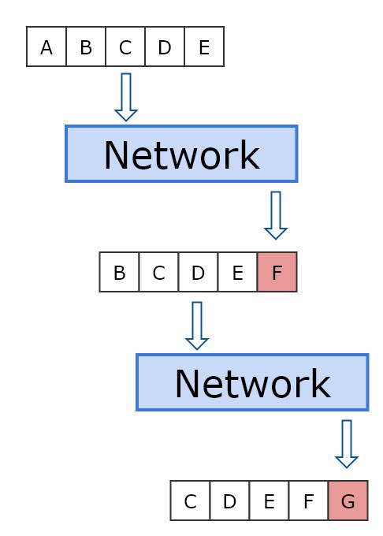
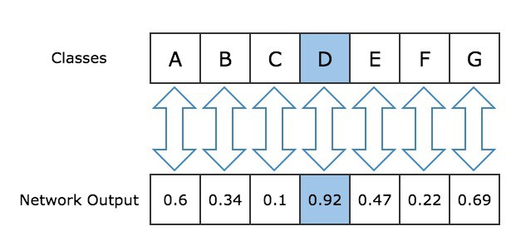
Sequence Generation
Model generates each note/chord by looking at the previous 200 and taking the highest probability next note/chord
This shifts the considered set by 1 each time
Diagrams courtesy of Sigurður Skúli, Towards Data Science.
Notes:
Utilize deep learning and neural networks in interpreting audio data
Generate new content which, perhaps, is removed from human environment
Supplement artistic work with new rhythms, beats and patterns generated by AI

Slide 8

Evaluation
As the model is generative (as opposed to discriminative), the best judges are us
Testing whether LSTM can successfully capture:
Repeating long term structure, strong temporal constraints
Low train and validation loss
Most importantly, pleasing to the ear
Notes:
Utilize deep learning and neural networks in interpreting audio data
Generate new content which, perhaps, is removed from human environment
Supplement artistic work with new rhythms, beats and patterns generated by AI

Slide 9
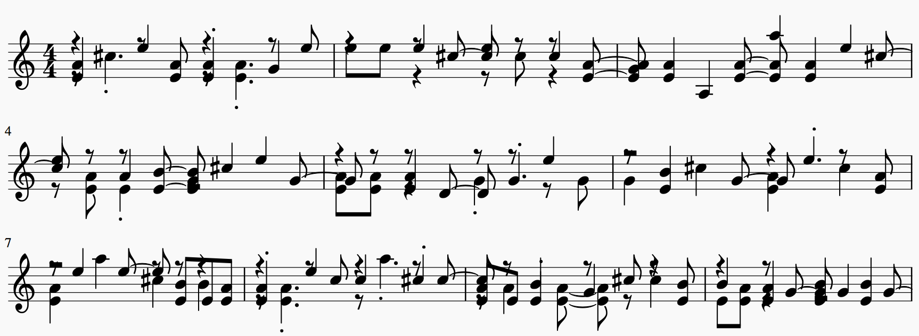
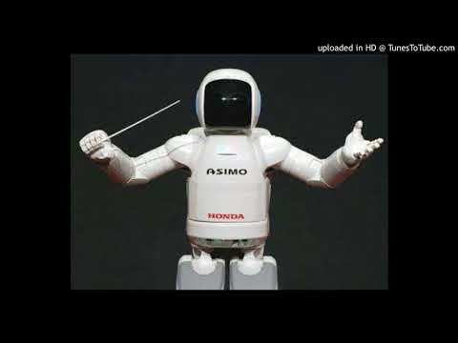
Celtic - Piano
Generated output from training on Celtic music
Robot image courtesy of trendhunter.com.

Slide 10
Key Takeaways
Explored one way a model can generate unique, new content
Evocative rhythmic patterns - but not in the running for awards just yet
Model just “scratches the surface” of generative modelling in music - more work to be done!
Notes:
Utilize deep learning and neural networks in interpreting audio data
Generate new content which, perhaps, is removed from human environment
Supplement artistic work with new rhythms, beats and patterns generated by AI

Slide 11
Next Steps
Continue to refine model performance. Explore a variety of:
Datasets - collections of music by genre, artist, style
Architectures - GAN, variational autoencoders, attention RNN
Inputs - raw audio, text
Write model into web app and implement online
Input a collection of music, output AI-generated content!

Slide 12




Thank You!
Listen to additional AI Jukebox creations at soundcloud.com/cipher813
linkedin.com/in/bcm822
github.com/cipher813/AI_Jukebox
medium.com/@cipher813
bcm822@gmail.com

Slide 13
Appendix

Slide 14
AI Jukebox
Generative model
LSTM
Exploration of creativity in AI
Notes:
Generative models: learn a joint probability distribution
Discriminative models: learn the conditional probability distribution
Speech recognition
Exploring creativity in AI
Investigate generative (as opposed to discriminative) neural networks
Exploring the question: can AI be creative?
Expands scope of artistic applications in the arts, both audio and visual
Investigate generative (as opposed to discriminative) model: important step in AI, generating new content, including images, text and audio, unbounded by human thought and environment (also key component of GANs)
LSTM/RNN important component of:
Sound and speech recognition
Time series prediction: traffic, recommender systems, stock movement
Natural Language Processing (NLP): machine translation, chatbots
Audio analysis and implementation essential for:
Sound and speech recognition
Digital assistants
Application of deep learning: testing the boundaries of AI ability to positively impact the human experience

Slide 15
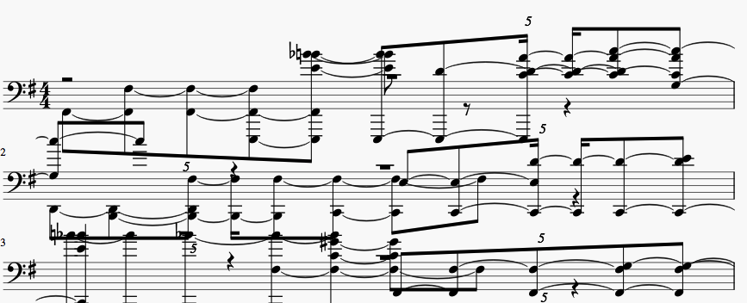

Dance - Drums
Generated output from training on dance music
Robot image courtesy of trendhunter.com.

Slide 16

Dance - Piano
Generated output from training on dance music
Piano
Robot image courtesy of trendhunter.com.

Slide 17
Datasets
Scraped by genre from various websites
Genre | # Midi | # Notes | # Unique Notes | Source
Celtic | 338 | 159,789 | 78 | Tadpole Tunes
Dance | 200 | 309,967 | 663 | MidiWorld
Jazz | 15 | 9,326 | 292 | MidiWorld
Game | 91 | 51,177 | 358 | Final Fantasy soundtracks*
*See blog post by Sigurour Skuli, Towards Data Science.

Slide 18
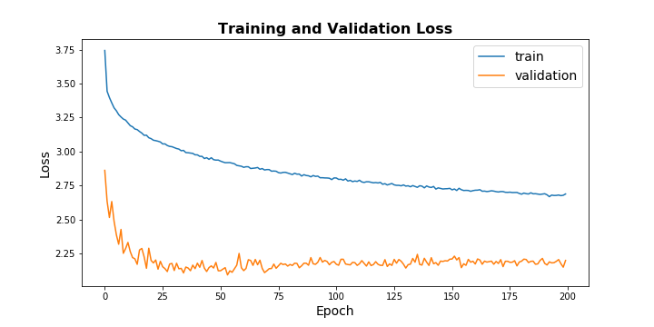
Evaluation Loss

Slide 19
A Model With Memory
Recurrent (esp. LSTM) model an essential component of:
Sound and speech recognition
Time series prediction: traffic, recommender systems, stock movement
Natural Language Processing (NLP): machine translation, chatbots
Digital assistants
Notes:
Generative models: learn a joint probability distribution
Discriminative models: learn the conditional probability distribution
Speech recognition
Exploring creativity in AI
Investigate generative (as opposed to discriminative) neural networks
Exploring the question: can AI be creative?
Expands scope of artistic applications in the arts, both audio and visual
Investigate generative (as opposed to discriminative) model: important step in AI, generating new content, including images, text and audio, unbounded by human thought and environment (also key component of GANs)
LSTM/RNN important component of:
Sound and speech recognition
Time series prediction: traffic, recommender systems, stock movement
Natural Language Processing (NLP): machine translation, chatbots
Audio analysis and implementation essential for:
Sound and speech recognition
Digital assistants
Application of deep learning: testing the boundaries of AI ability to positively impact the human experience

Slide 20

Recurrent Network
Diagram courtesy of “colah’s blog” at https://colah.github.io/posts/2015-08-Understanding-LSTMs/
Notes:
Utilize deep learning and neural networks in interpreting audio data
Generate new content which, perhaps, is removed from human environment
Supplement artistic work with new rhythms, beats and patterns generated by AI

Slide 21
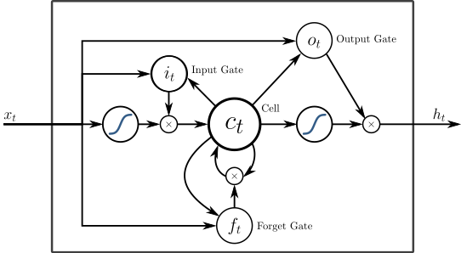
LSTM Diagram (2)
Diagram courtesy of “colah’s blog” at https://colah.github.io/posts/2015-08-Understanding-LSTMs/
Notes:
Utilize deep learning and neural networks in interpreting audio data
Generate new content which, perhaps, is removed from human environment
Supplement artistic work with new rhythms, beats and patterns generated by AI

Slide 22
Creativity in AI
A long disputed and contentious question: can AI be creative?
“Remixing” precedent with a dose of stochasticity
Potential to generate new thoughts and ideas unbounded by the human experience
Notes:
Generative models: learn a joint probability distribution
Discriminative models: learn the conditional probability distribution
Speech recognition
Exploring creativity in AI
Investigate generative (as opposed to discriminative) neural networks
Exploring the question: can AI be creative?
Expands scope of artistic applications in the arts, both audio and visual
Investigate generative (as opposed to discriminative) model: important step in AI, generating new content, including images, text and audio, unbounded by human thought and environment (also key component of GANs)
LSTM/RNN important component of:
Sound and speech recognition
Time series prediction: traffic, recommender systems, stock movement
Natural Language Processing (NLP): machine translation, chatbots
Audio analysis and implementation essential for:
Sound and speech recognition
Digital assistants
Application of deep learning: testing the boundaries of AI ability to positively impact the human experience

Slide 23
Lessons Learned
Successfully implemented a functional AI music generator
Tested the audio and generative capabilities of neural networks
Utilized various audio format preprocessing
Notes:
Utilize deep learning and neural networks in interpreting audio data
Generate new content which, perhaps, is removed from human environment
Supplement artistic work with new rhythms, beats and patterns generated by AI

Slide 24
Resources
Dorsey, Brannon. “Using Machine Learning to Create New Melodies.” https://brangerbriz.com/. 10 May 2017.
Nayebi, Aran. "GRUV: Algorithmic Music Generation using Recurrent Neural Networks." Stanford University. 2015.
Skúli, Sigurður. "How to Generate Music using a LSTM Neural Network in Keras." www.towardsdatascience.com. December 7, 2017.
Brownlee, Jason. "Stacked LSTM Networks." https://machinelearningmastery.com. August 18, 2017.
Brownlee, Jason. "Understand the Difference Between Return Sequences and Return States for LSTMs in Keras." https://machinelearningmastery.com. October 24, 2017.
“Understanding LSTM Networks.” Colah’s Blog. https://colah.github.io. 27 August 2015.
Goodfellow, Ian. “Deep Learning.” MIT Press. http://www.deeplearningbook.org/. 2016.
“Magenta.” Tensorflow. Magenta.tensorflow.org.

